Slide 1
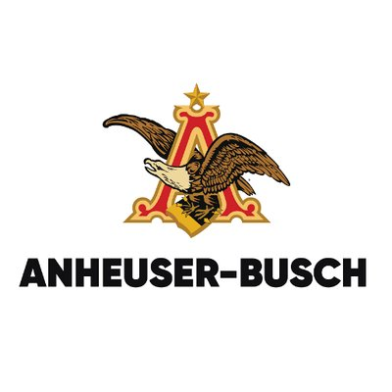
Anheuser-Busch Data Analysis
Daniel Byrne
Joanna Duran
Matthew Norton

Slide 2
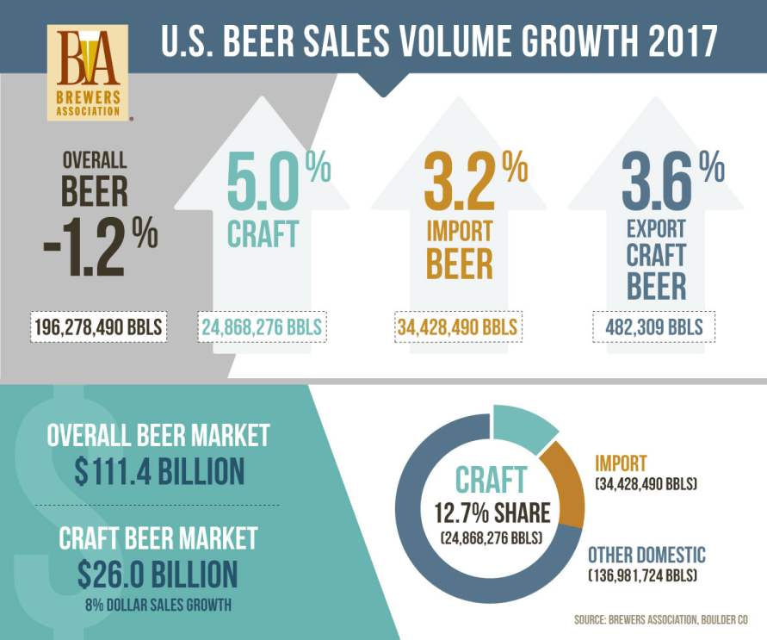
Background
According to Brewers Association for Small and Independent Craft Brewers
Overall U.S. beer volume sales were down 1% in 2017
Craft brewer sales grew 5%, reaching 12.7% of the U.S. beer market
Craft increased 8%, up to $26.0 billion
Craft account for more than 23% of the $111.4 billion U.S. beer market.
https://www.brewersassociation.org/statistics/national-beer-sales-production-data/

Slide 3
Purpose
While Anheuser Busch still has a large market share, but craft breweries are on the rise and are a threat to future market share
Our team was presented the raw data on U.S. microbrewery beers provided by the market research department
Examine
patterns that could be used in developing new marketing opportunities
tally and visualize the number of craft breweries by state
summarize the statistical parameters of alcohol and bitterness
relationships of these parameters with each other and with the states in which they were produced.

Slide 4
What the data looks like
Noticed a few abnormalities in the data
1005 out of 2410 (41.7% ) did not have an IBU value.
62 out of 2410 (2.57%) did not have a ABV value
Will eliminate the beers that have neither ABV nor IBU
Brewery | City | State | Beer | ABV | IBU | Style | Ounces
Top Six Observations
NorthGate Brewing | Minneapolis | MN | Pumpion | 0.060 | 38 | Pumpkin Ale | 16
NorthGate Brewing | Minneapolis | MN | Stronghold | 0.060 | 25 | American Porter | 16
NorthGate Brewing | Minneapolis | MN | Parapet ESB | 0.056 | 47 | Extra Special / Strong Bitter (ESB) | 16
NorthGate Brewing | Minneapolis | MN | Get Together | 0.045 | 50 | American IPA | 16
NorthGate Brewing | Minneapolis | MN | Maggie's Leap | 0.049 | 26 | Milk / Sweet Stout | 16
NorthGate Brewing | Minneapolis | MN | Wall's End | 0.048 | 19 | English Brown Ale | 16
Bottom Six Observations
Tröegs Brewing Company | Hershey | PA | Perpetual IPA | 0.075 | 85 | American IPA | 12
Tröegs Brewing Company | Hershey | PA | Troegenator Doublebock | 0.082 | 25 | Doppelbock | 16
Mission Brewery | San Diego | CA | Cortez Gold | 0.050 | NA | Belgian Pale Ale | 32
Mission Brewery | San Diego | CA | Mission IPA | 0.068 | 66 | American IPA | 32
Mission Brewery | San Diego | CA | El Conquistador Extra Pale Ale | 0.048 | 44 | American Pale Ale (APA) | 32
Mission Brewery | San Diego | CA | Shipwrecked Double IPA | 0.092 | 75 | American Double / Imperial IPA | 32

Slide 5
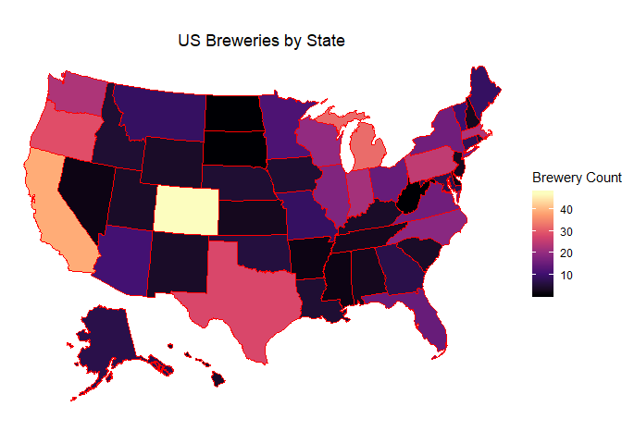
How many breweries are present in each state?
Highest State - Colorado with 47 breweries
Some states only have 1.
Good indicator of market saturation per state

Slide 6
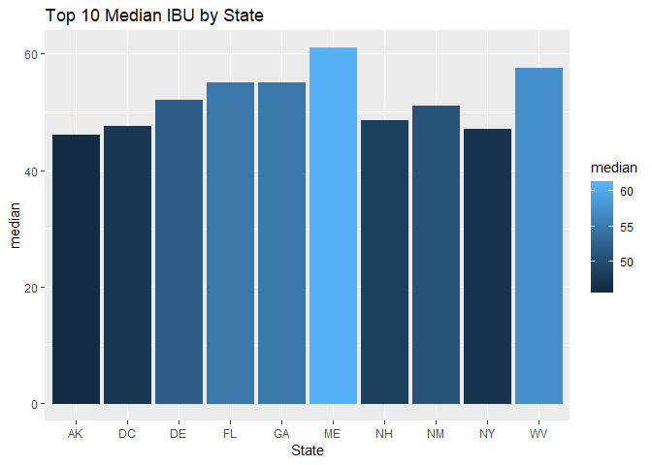
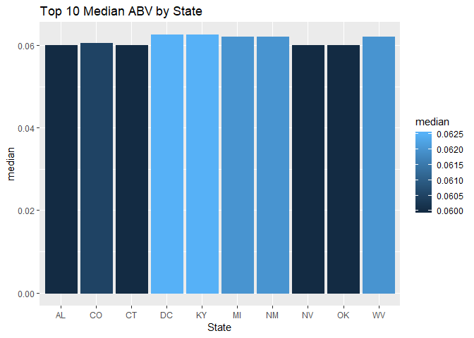
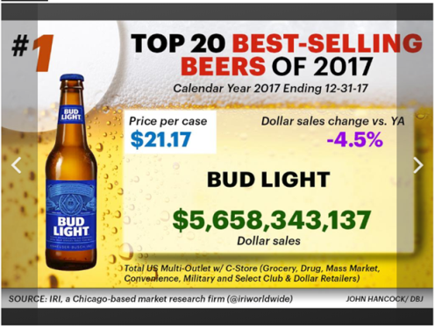
median alcohol content and international bitterness unit for each state
Analyzed median ABV and IBU per each state.
Compared to your #1 best seller- Bud Light.
Small variation in median ABV per state, majority range between 0.050 to 0.063.
Bud Light is 0.042, below the median of each state.
Greater variation in the median IBU per state, range between 19 to 61.
Bud Light is 10, far below the median of each state
https://www.bizjournals.com/dayton/news/2018/09/30/here-are-the-top-20-best-selling-beer-brands-in.html

Slide 7
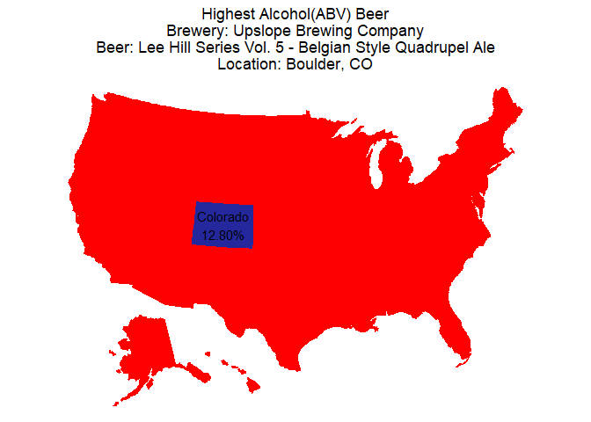
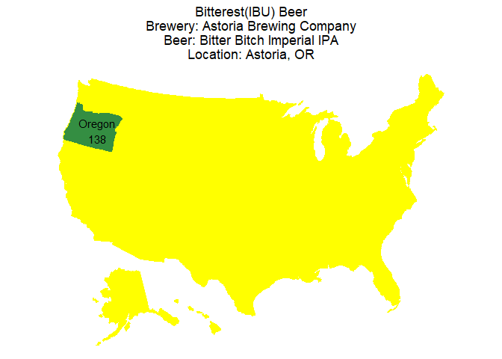
Max ABV And IBU
Examine relationships between Max ABV and IBU by state
The state with the maximum alcoholic beer is Colorado 12.8% ABV
The state with the most bitter beer is Oregon with 138 IBU
Highest ABV and IBU do not come from the same state

Slide 8

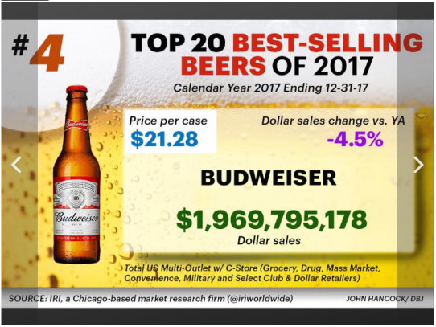
ABV analysis
ABV Analysis
Average ABV is 0.059.
Max ABV is 0.128 while the Min is 0.001, this is a pretty wide range
The 0.001 beer is a “Low Alcohol Beer” while the 0.128 is a “Quadruple” style beer
Microbreweries are catering to a large range of ABV tastes
Your best selling brands are under the ABV average (Bud Light ABV= .042, Budweiser ABV= .050)
https://www.bizjournals.com/dayton/news/2018/09/30/here-are-the-top-20-best-selling-beer-brands-in.html

Slide 9
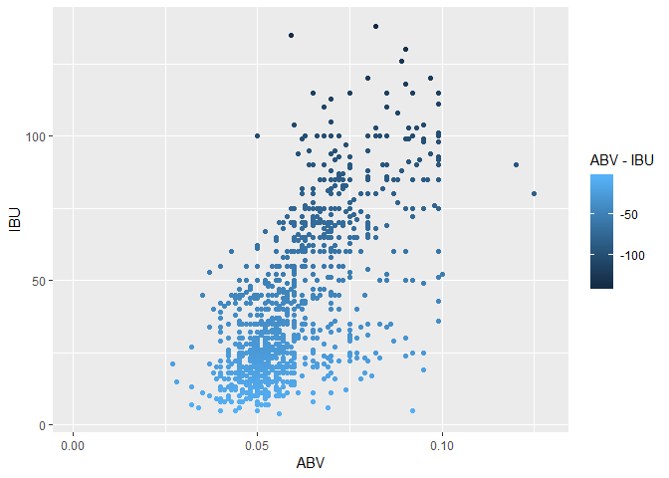
ABV/ IBU Relationship
IBU increases as ABV increases
Must note that we only have an IBU value for 41.7% of the 2410 beers therefore further analysis may be needed

Slide 10
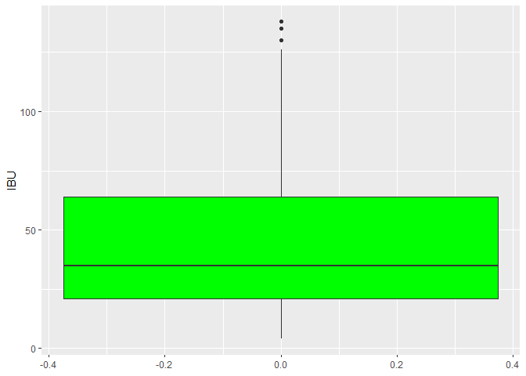
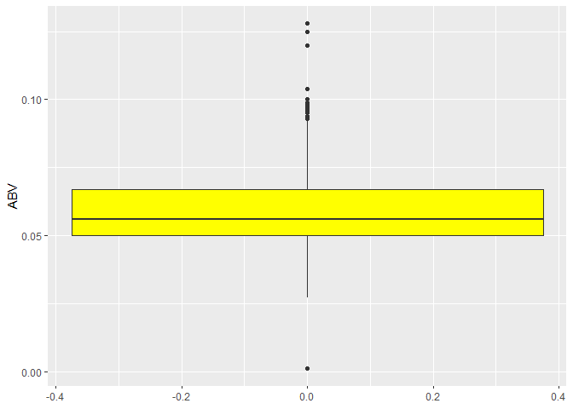
Summary
Your top selling beers, Bud Light and Budweiser are under the median ABVs and IBUs as compared to craft beers.
Cost/Benefit Analysis would be beneficial to explore higher ABV/ IBU markets.
In depth analysis of Colorado is recommended for possible acquisitions and consolidation.
ABV mean ~6%. However, tended towards 10-12% suggesting a changing trend.

Slide 11
Summary
Alcohol Content and Bitterness showed a correlation, but the strength of that correlation was not examined in this analysis.
Further investigation is recommended for determining geographic significance or breweries and testing for regional palates.

Slide 12
Appendix

Slide 13
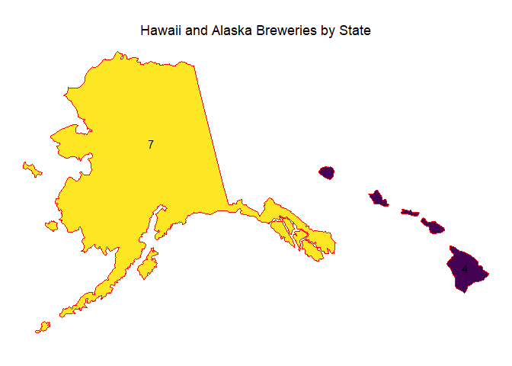
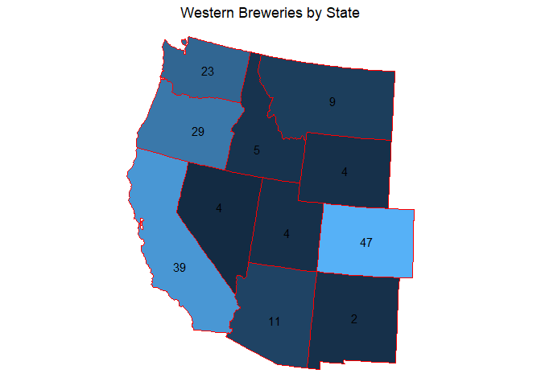
Breweries by region

Slide 14
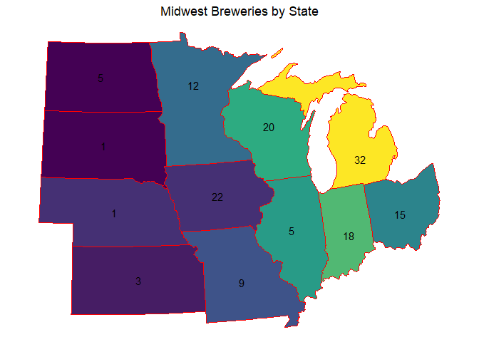
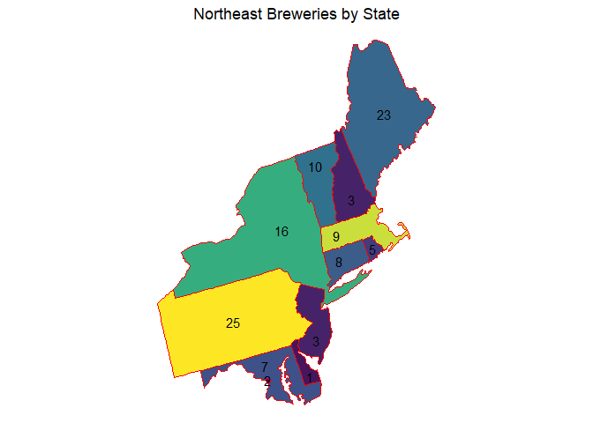
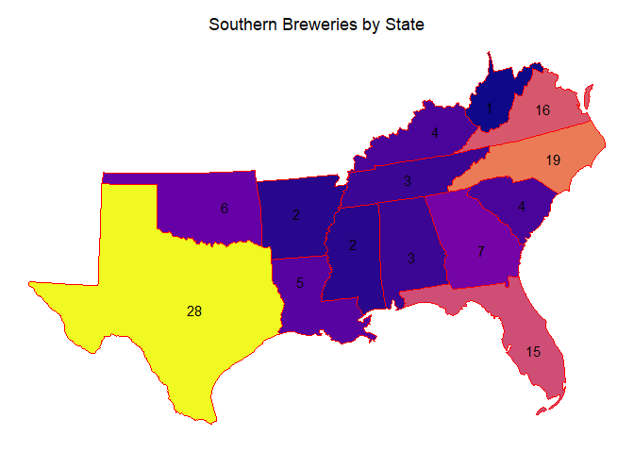
Breweries by region

